Slide 1
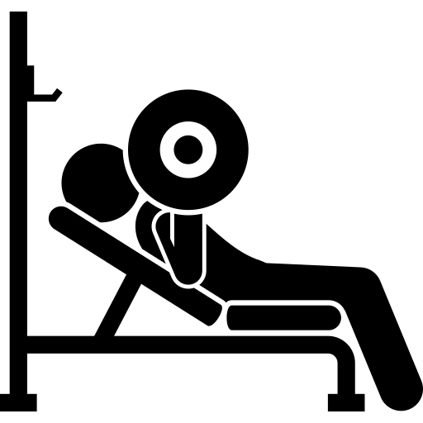


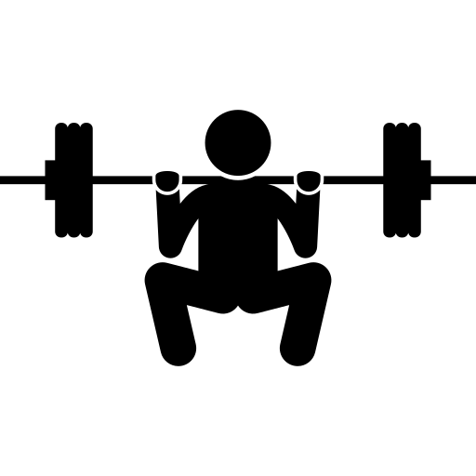

A GMRA approach to Workout Optimization
COSC3997
Senior Practicum
Evan Wells

Slide 2
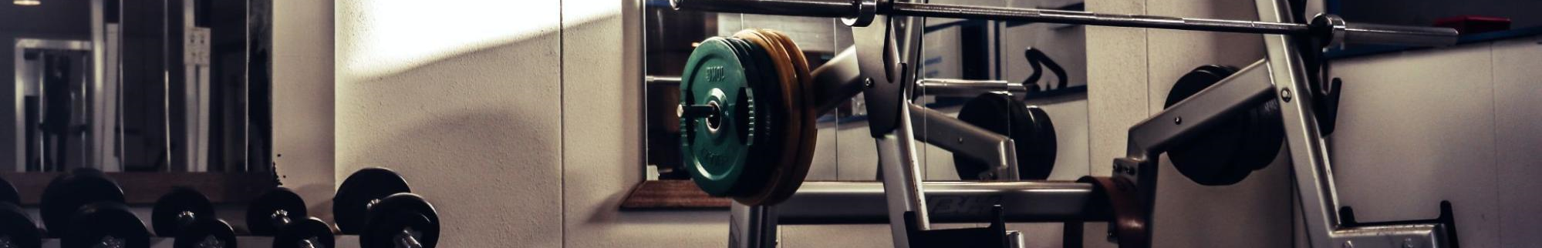
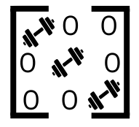
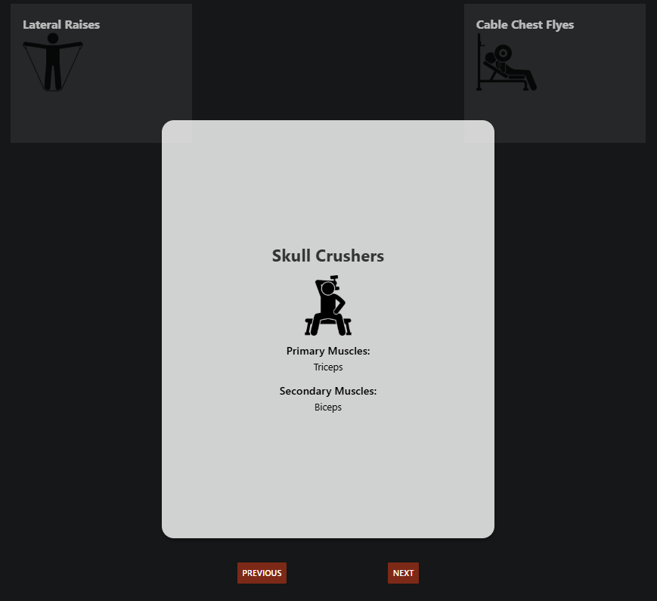
Concept
My goal with the project was to leverage Group Multi Role Assignment (GMRA) to optimize the exercises picked for a certain workout session. Using targeted muscle groups as a basis, this application quantifies muscle use for exercises and returns the most well-balanced workout for given inputs.
As learning was also a priority, challenges were sought after, such as creating and implementing a 3-D model, formatting the whole as an application, etc.

Slide 3







Resources Used
Used in backend (Python)
PuLP – Linear programming modeling
NumPy – Computing library
Pandas – Dataset operation library
Flask – Web framework
Used in frontend (ts & js)
Expo – App development
React Native – UI framework
Three.js – 3D graphics framework

Slide 4
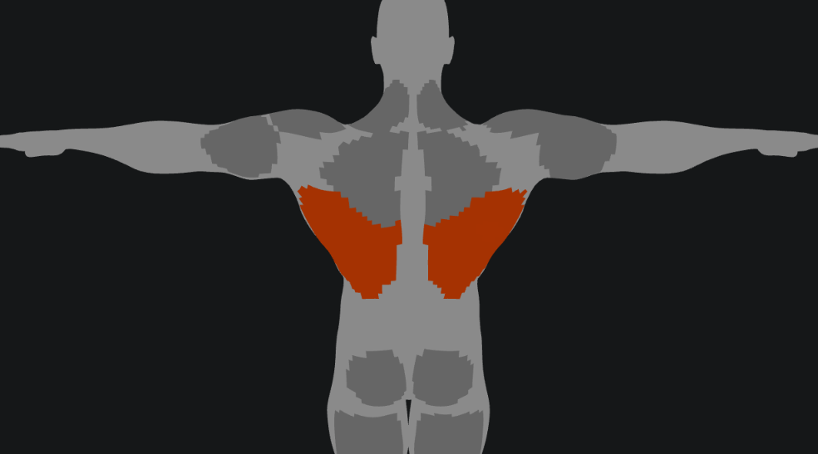
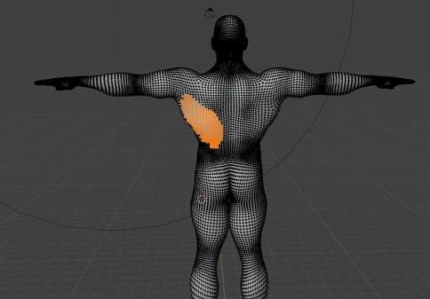
Blender and 3-D Rendering
The usage of a 3-D model allows for users to have an interactive display of their potential workouts. Clicks on a certain muscle group stack up and darken to allocate importance.
This is done through numerous layers, separating the muscle groups. The data gathered from the shade of the muscles is quantified into a role range vector (L)

Slide 5

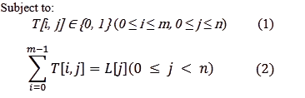
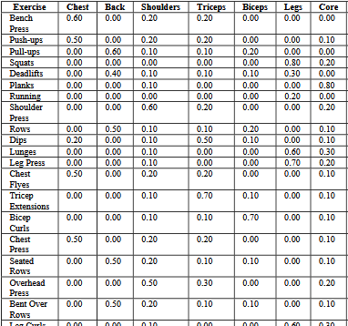
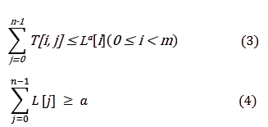
GMRA Algorithm
The GMRA algorithm uses the muscle selections from the
3-D model and the muscle usage per exercise data to optimally assign exercises for the user. The Group Multi Role Assignment algorithm returns a workable T confined to the constraints seen to the left. As such, the algorithm provides the best (given amount of) exercises to maximize muscle use for the
specified muscles (L). The T matrix
received indicates which exercises
work which muscles by assigning a
value of 1 to the relevant T[i, j]
position.

Slide 6
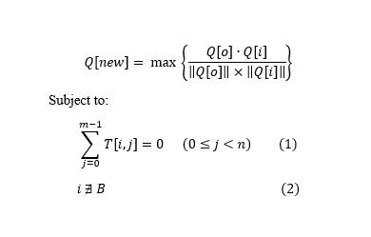
Shuffle
A shuffle option is available for each assigned exercise, to accommodate to user (mismatch of equipment, injury, disinterest, etc.) The shuffle is decided through cosine similarity, treating each exercise as a vector and comparing them.
Through this process and certain constraints, the closest exercise, in terms of muscle use, can be found and switched out.

Slide 7
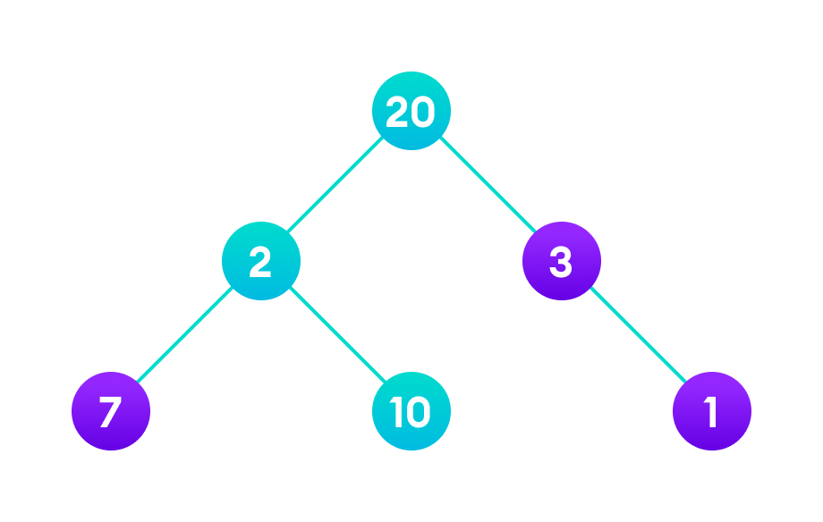
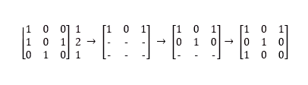
Sorting Exercises
To avoid the same muscle group being called sequentially, the Greedy Algorithm was implemented to sort the assigned exercises. The process was as follows:
Each exercise was assigned a value for the number of muscles engaged
Starting with the exercise with the highest value, the best following exercise is computed (least amount of spillover)
This process continues until no exercises remain
Greedy algorithm

Slide 8
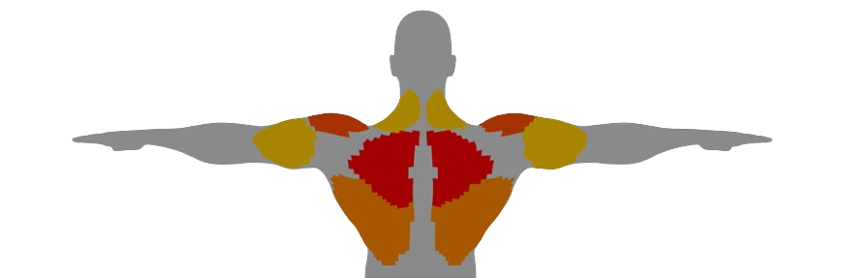
Conclusion
In sum, the projects demonstrates the utility of Role Based Collaboration and viewing the world as a sum of objects. Through this line of thinking, the muscle groups of the body can be defined as roles and exercises can be quantified into a ratio of role usage. Through this one can effectively optimize workouts given a desired usage of muscles and number of exercises.

Slide 9
References
Blender Foundation. Modeling meshes. Blender Manual. https://docs.blender.org/manual/en/latest/modeling/meshes/index.html
FreeTrainers. Muscle exercises. FreeTrainers. https://www.freetrainers.com/exercise/muscle/
GeeksforGeeks. Greedy algorithms. GeeksforGeeks. https://www.geeksforgeeks.org/greedy-algorithms/
LearnDataSci. Cosine similarity. LearnDataSci. https://www.learndatasci.com/glossary/cosine-similarity
Three.js. Three.js documentation. Three.js. https://threejs.org/docs/
Zhu H, Liu D, Zhang S, Teng S, Zhu Y. Solving the Group Multirole Assignment Problem by Improving the ILOG Approach[J]. IEEE Transactions on Systems, Man, and Cybernetics: Systems, 2017, 47(12): 3418-3424
Zhu H, E-CARGO and Role-Based Collaboration: Modeling and Solving Problems in the Complex World, Wiley-IEEE Press, NJ, USA, Dec. 2021.

